Slide 1


K.RAMAKRISHNAN COLLEGE OF ENGINEERING
(AUTONOMOUS)
HOSTEL MANAGEMENT SYSTEM
Presented by,
Name : RAGHUL K
Register No. : 8115U24AM043
Roll No. : AM2443
Year : II /CSE(AIML)
Date of Review : 06/05/2026

Slide 2
PRESENTATION OVERVIEW
Objective
Introduction
Abstract
Architecture Diagram
Module Description
Implementation
Conclusion

Slide 3
OBJECTIVE
The main objective of the Hostel Management System is to efficiently manage hostel operations such as student registration, room allocation, fee management, attendance tracking, and complaint handling.
It aims to reduce manual work and paperwork by providing a centralized and user-friendly digital platform for managing all hostel-related activities.
The system also helps in maintaining accurate records, improving communication between students and administration, and ensuring smooth day-to-day hostel operations.

Slide 4
INTRODUCTION
To develop a centralized and user-friendly Hostel Management System that streamlines the process of managing hostel-related activities—such as room allocation, student registration, attendance tracking, fee management, complaint handling, and record maintenance—in order to enhance efficiency, accuracy, and transparency while improving communication and overall management experience for both administrators and residents.

Slide 5
ABSTRACT
The Hostel Management System is a digital platform designed to simplify and automate the process of managing hostel-related operations. Traditionally, hostel administration tasks such as room allocation, student records maintenance, fee collection, and complaint handling are performed manually, which can be time-consuming, error-prone, and inefficient as the number of residents increases.

Slide 6
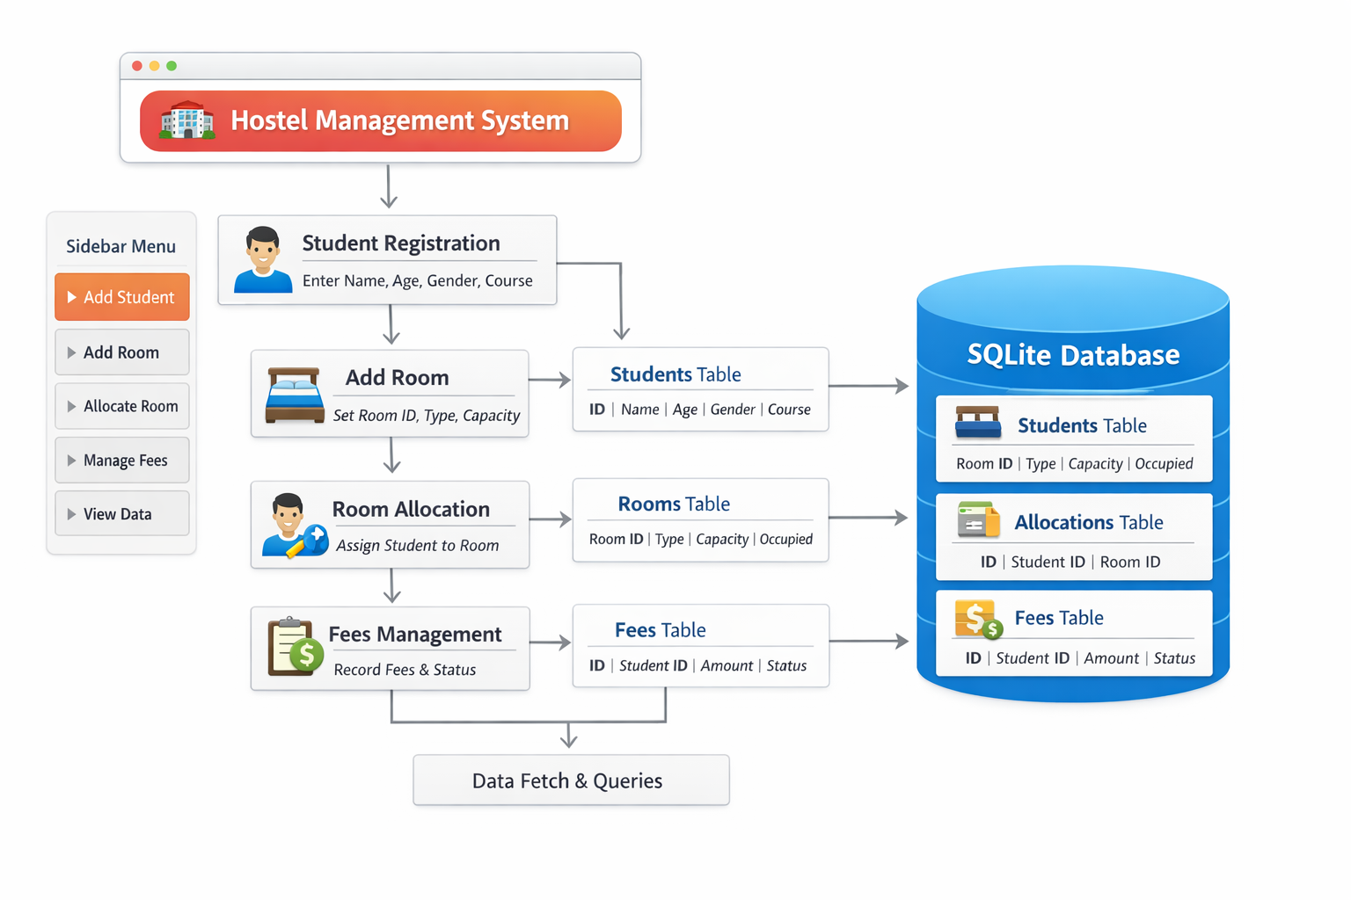
ARCHITECTURE DIAGRAM
.

Slide 7
MODULE DESCRIPTION
Student Management Module – Register new students – Store student details (name, age, gender, course)
2. Room Management Module – Add and manage rooms – Set room type and capacity
.

Slide 8
MODULE DESCRIPTION
3. Room Allocation Module – Assign rooms to students – Track room occupancy
Manage users and books
4. Fees Management Module – Record student fee details – Update payment status (Paid/Pending)
.

Slide 9
MODULE DESCRIPTION
5. User Interface Module
– Provide interactive dashboard using Streamlit
– Input forms and navigation menu
6. Database Management Module
– Store data using SQLite
– Perform CRUD operations
7. View Module
– View student records
– Display stored data (rooms, fees, allocation)
.

Slide 10
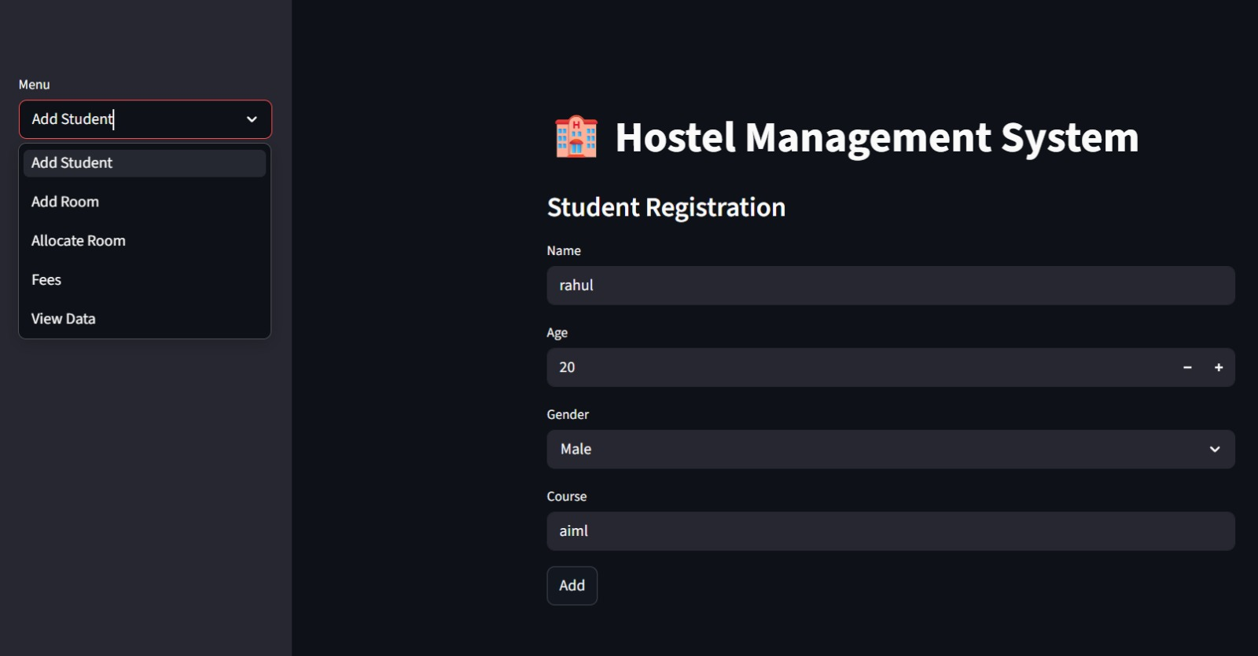
IMPLEMENTATION

Slide 11
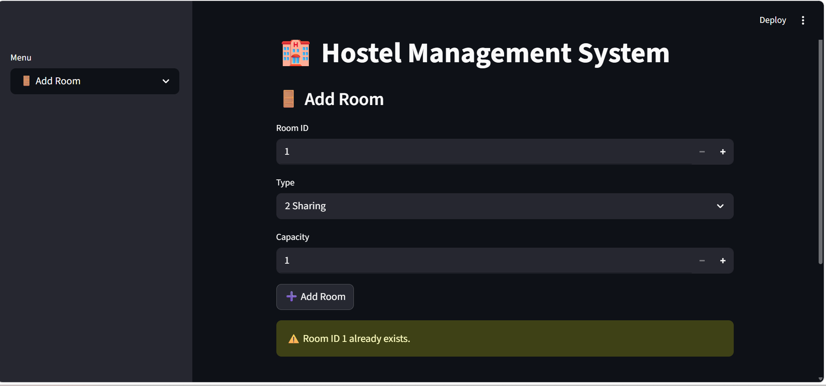
IMPLEMENTATION

Slide 12
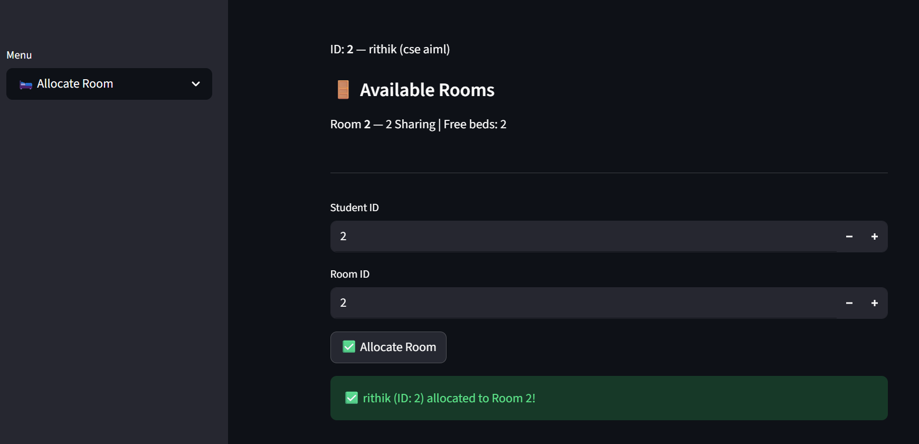
IMPLEMENTATION

Slide 13
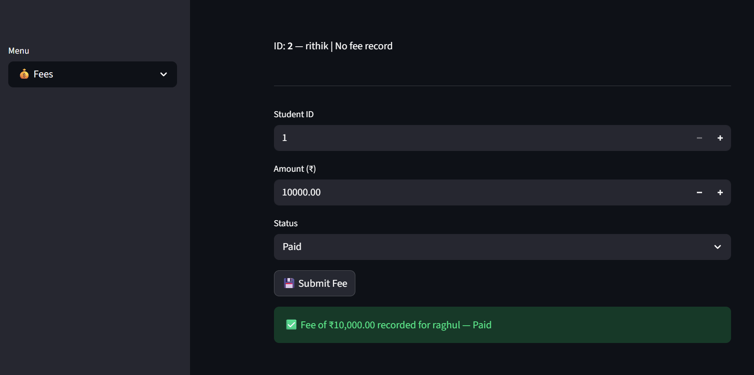
IMPLEMENTATION

Slide 14
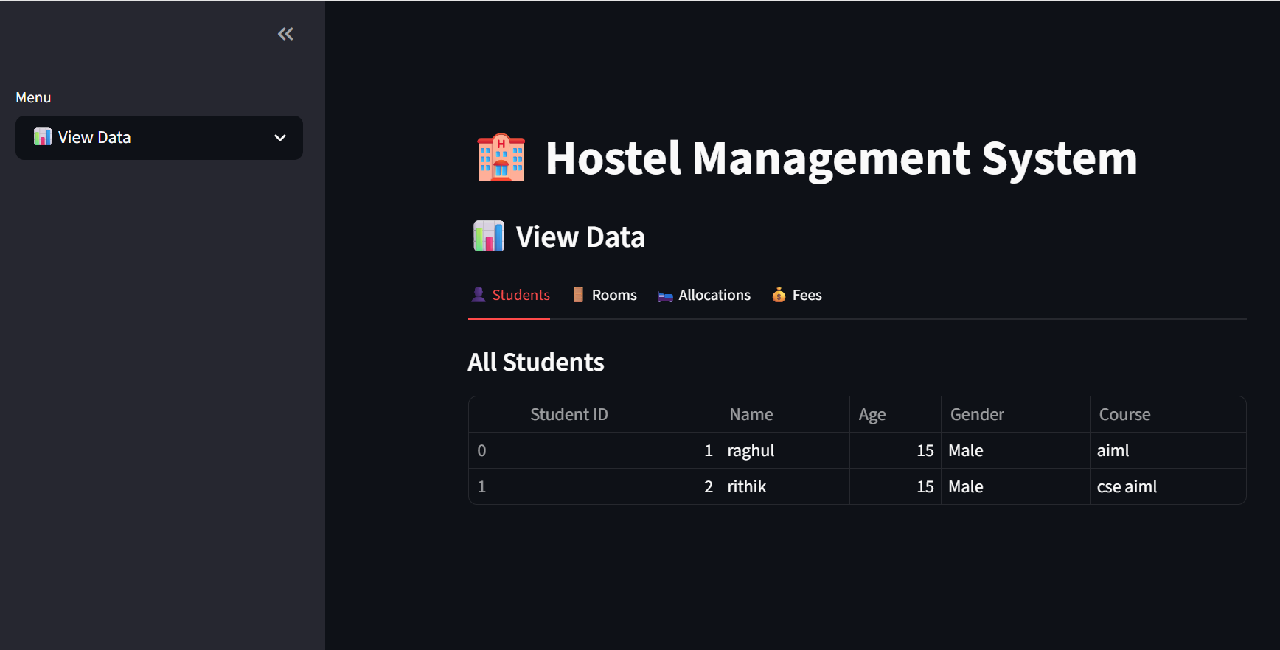
IMPLEMENTATION

Slide 15
CONCLUSION
The project provides a simple and efficient way to manage hostel activities through a centralized digital system, improving overall administrative convenience. Integration with a structured database ensures quick and accurate handling of hostel details such as room allocation, student records, fee management, and complaints. The system makes hostel management easier for administrators and residents, especially those with limited technical knowledge, by offering a user-friendly and interactive interface.

Slide 16


